Slide 1
MOC Training
Karen Hitchcock
July 2025

Slide 2
MOC – Management Of Change
When do we need a MOC?
Making a change that is not replacement in kind (Not like for like)
Where is the procedure & forms?
\\USGURFS002\Data\Procedures\SAFETY & ENVIRONMENTAL MANUAL\Process Safety Management Files\Gurnee PSM Manual\L_Management of Change\02) Management of Change- MOC\
Which form do I use?
Safety System Impairment
MOC
Management of Personal and Organization

Slide 3
MOC – Types & Levels
There are different Types & Levels of MOC’s:
Type:
Permanent
Temporary – needs an expiration date
Impairment – use Safety System Impairment Form
Levels: Complete MOC Hazard Assessment to determine level
Level 1 uses Level 1 form
Level 2, 3, & 4 uses Level 2 form
Level 3 MOC’s require a What If… Process Hazard Analysis to be completed.
Level 4 MOC’s require a Hazop Process Hazard Analysis to be completed.
CHANGE RISK LEVEL | LOW Significance | HIGH Significance
LOW Degree of Hazard | LEVEL 1 | LEVEL 2
HIGH Degree of Hazard | LEVEL 3 | LEVEL 4

Slide 4
Level 1 Flow
Requestor completed Level 1 MOC form & Appendix A to identify action items
Requestor attaches / provides additional information, specifications, drawings, etc. on the change
Process Safety Closes MOC
Process Safety confirms all documentation is correct
Requestor provides folder / documentation to Process Safety
Requestor confirms Action items are closed and completes Part 2 of form
Implement the change & close actions
Requestor gets approval from Process Safety and a MOC # is assigned
Requestor gets approval from a Manager (typically Domingo or Tony)

Slide 5
Level 2 Flow
Requestor completed Level 2 – Part 1 MOC form & Appendix A to identify action items
Requestor attaches / provides additional information, specifications, drawings, etc. on the change
Process Safety Closes MOC
Requestor confirms Action items are closed and completes Part 4 of form
Part 3 Starts – Production Manager approves operation of change & commissioning of equipment is started.
Implement Change & conduct PSSR if required
Part 2 starts – Requestor completes detailed design of change and seeks approval with associated documentation.
Process Safety assigns MOC # and schedules PHA if needed.
Requestor gets approval from both Production & Technical Managers. Technical Manager also complete Appendix B on other documentation needed.
Approval to proceed granted by MOC Requestor, Production Manager, Technical Manager, Maintenance Manager, & EHS Manager.
If temporary, Requestor confirms equipment & documentation are reverted back to state prior to MOC.
Process Safety confirms all documentation is correct

Slide 6
PSSR – Pre-Startup Safety Review
If new equipment is being installed, a PSSR is required.
Where is the PSSR procedure & forms?
\\USGURFS002\Data\Procedures\SAFETY & ENVIRONMENTAL MANUAL\Process Safety Management Files\Gurnee PSM Manual\I_Pre-Startup Safety Review\
Level 1 PSSR – simple equipment modifications (1 page)
Level 2 PSSR – more involved equipment changes (21 pages)
Punchlist Template – to track actions from PSSR

Slide 7
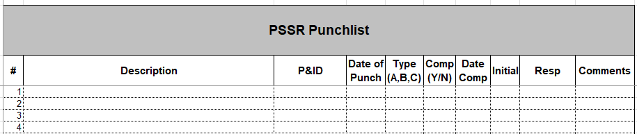
PSSR Actions
Punchlist Template
A = Required to be completed prior to reinventorying of hazards chemicals
B = Required during hot commissioning
C = To be completed after start-up / prior to MOC closure

Slide 8
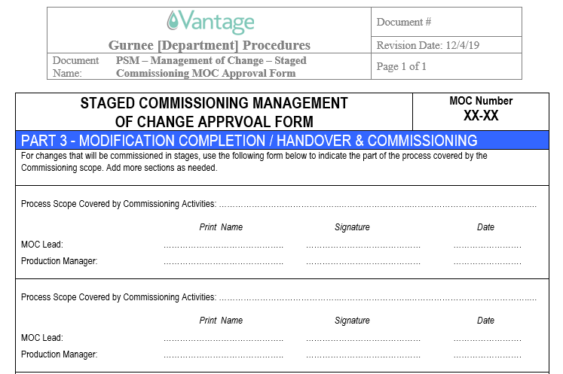
Other Forms – Staged Commissioning

Slide 9
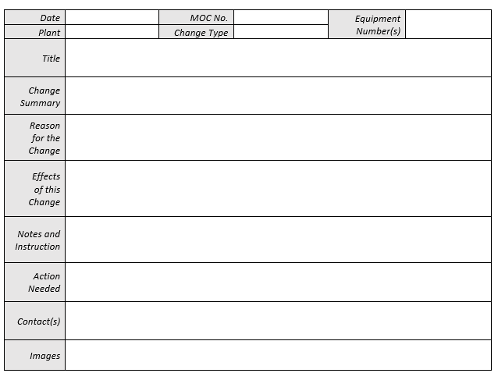
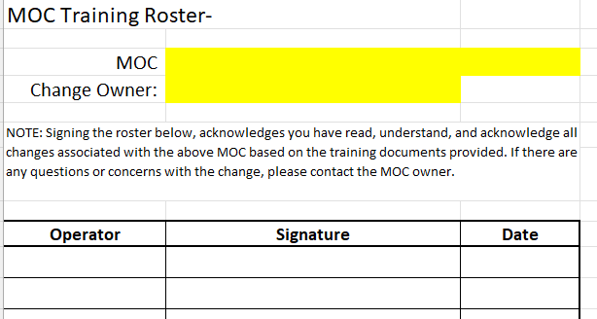
Other Forms – MOC Change Notification

Slide 10
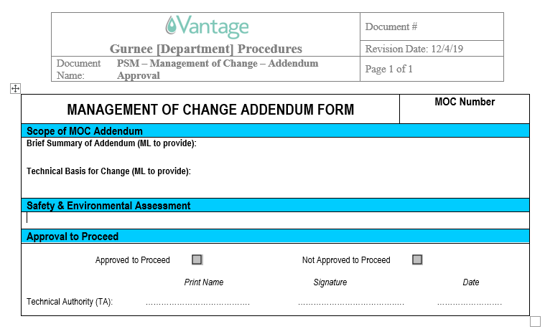
Other Forms – Addendum

